Slide 1


GAMING
GAMING

Slide 2








What We Gain
Problem solving capability
Hand-eye coordination

Slide 3




Fine motor and spatial skills
Decision making

Slide 4
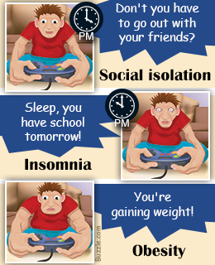
But…. We lose…..

Slide 5

Preoccupation
Headache
Strained eye
Suffering relationships
Increased aggression
Poor performance

Slide 6





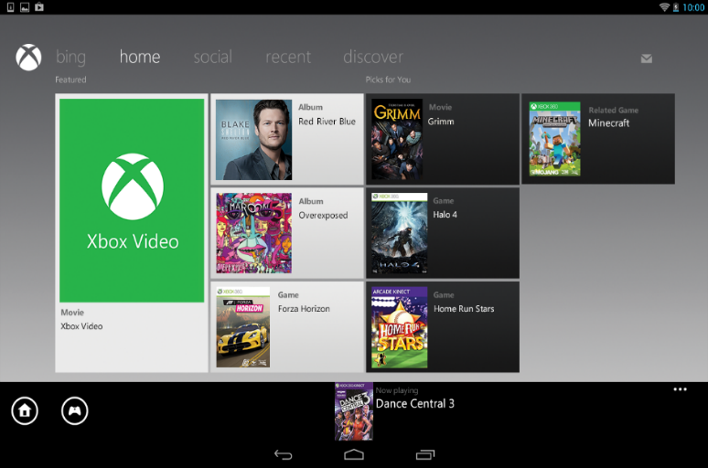


Boxed games
Digital download
Mobile storefronts
Subscription
Free-to-play: freemium
Social networking games

Slide 7


Slide 8
Keep a clean machine
Make your password Strong
Protect your personal information
Protect your identity
Don’t download without parental permission
Be a good digital citizen
Have effective and updated -antivirus/antispyware software
Play only with authorized versions of games
Verify the authenticity and security of downloaded games
keep the game software up to date
Speak up
Report cyberbullies
Put a time limit for game playing
When in doubt, throw it out
Think before you act
Hit the mute button
Block the player
Check the rating
Keep the computer out in the open
Be web-wise

Slide 9


Slide 10



Slide 11
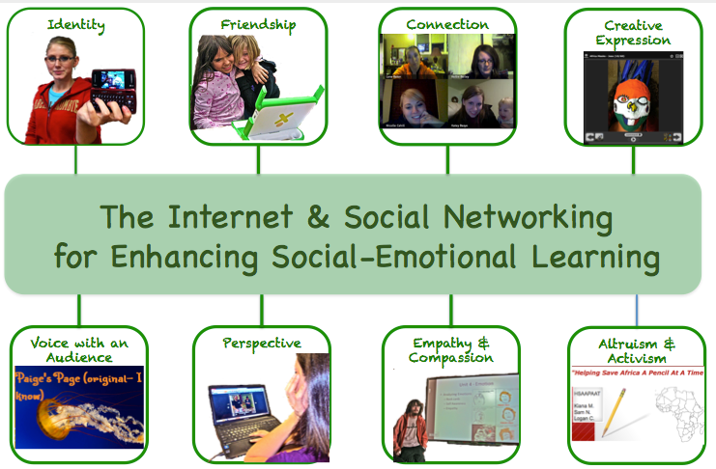

Slide 12


Slide 13











Bookmarking
Social News
Blogs
Microblogs
Social Networking
Media Sharing
Virtual World

Slide 14


Contact information
Pictures you don’t want everyone to see
Information about your school or work
Your travel plan
New purchases
Friends in ‘unglam’ shots
Chain status updates
Assume any communication is private
Add friends you don’t really know
Disable privacy on your accounts
Comment on every post
Tag people in irrelevant posts
Send random application/game invites

Slide 15
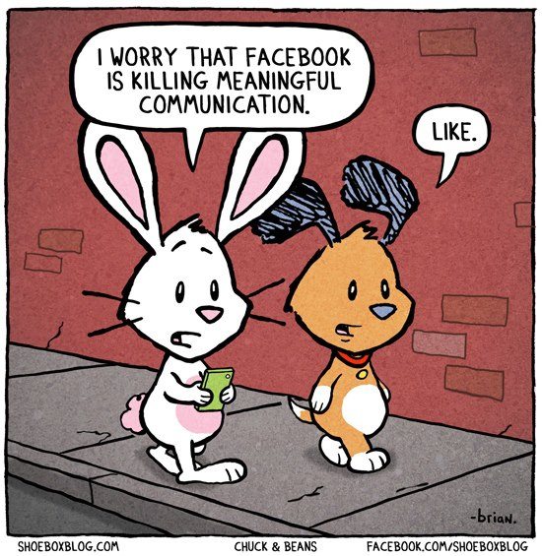

Lacks Emotional Connection
Gives People a License to be Hurtful
Decreases Face-to-Face Communication Skills
Conveys Inauthentic Expression of Feelings
Facilitates Laziness
Causes Face-to-Face Interactions to Feel Disconnected
Reduces Family Closeness
Creates a Skewed Self-Image
Causes Distractions
Reduces Physical Activities

Slide 16
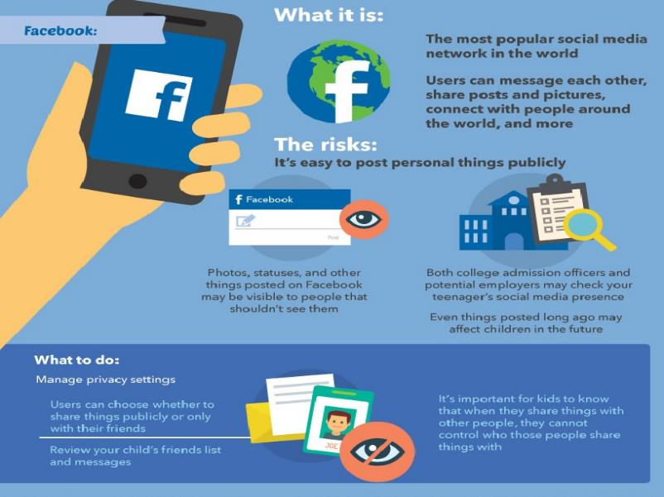
Facebook Contents and privacy

Slide 17

Do not share your personal information or valuable information. It may be saved in the server and can be hacked.
Do not respond to unknown users; block them.
Make sure that you are not clicking on unknown links or images. These can hack your data on your phone
Don’t join every group that you are invited or added to.
Share settings should be set to “my contacts.”
Be careful while sharing any information in WhatsApp groups.
Opens the Door to Strangers
Raises Probability of Sexting
Increases the Vulnerability to Cyberbullying
Easy to Share Location Details

